Slide 1
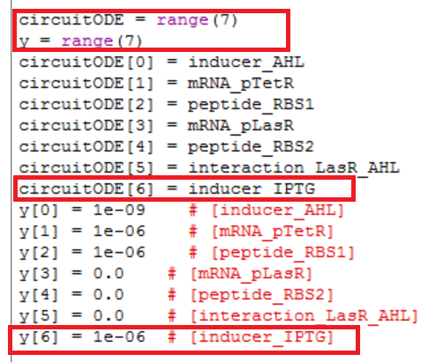
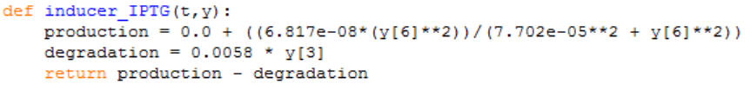
5. ALL: How to change the model so that LasR is now IPTG inducible?

Slide 2
6. ALL: How will GFP level differ at steady state when you vary [IPTG] and [AHL] (hint: You need a 3-D graph)? Is steady-state achieved within the same duration?

Slide 3
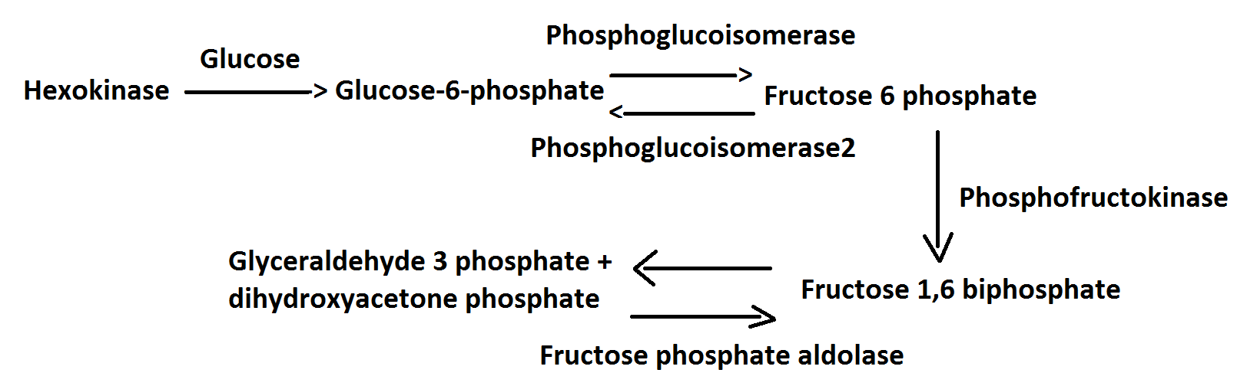
Pathway Model

Slide 4
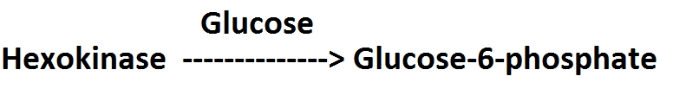
7. Hexokinase metabolizes glucose into gluose-6-phosphate in a non-reversible fashion. Write the ODEs for this model, implement and simulate the model.

Slide 5
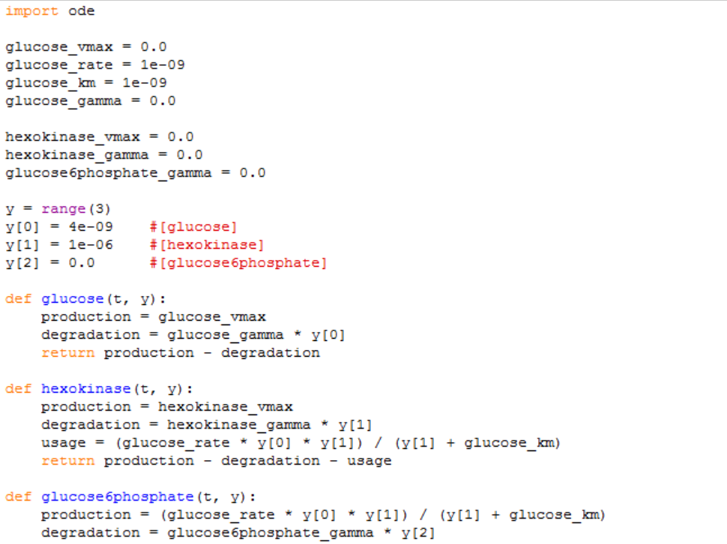
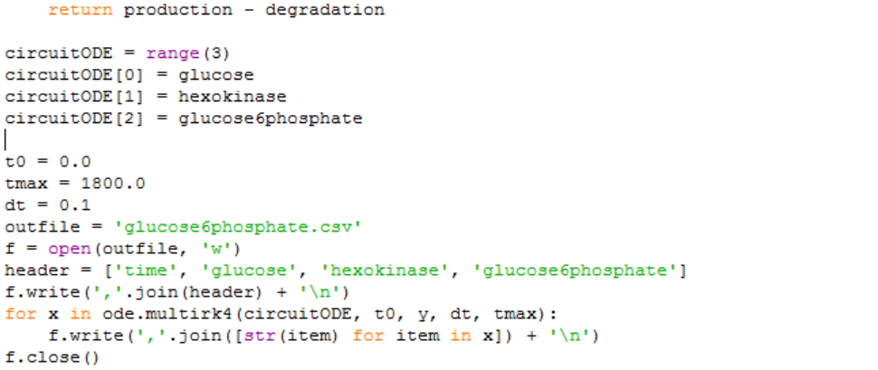
7. Hexokinase metabolizes glucose into gluose-6-phosphate in a non-reversible fashion. Write the ODEs for this model, implement and simulate the model.

Slide 6
8. How will increasing the level of hexokinase affect gluose-6-phosphate production rate?
Ans: By increasing the level of hexokinase will also increase the rate of glucose-6-phosphate production. (show both tables in excel)

Slide 7
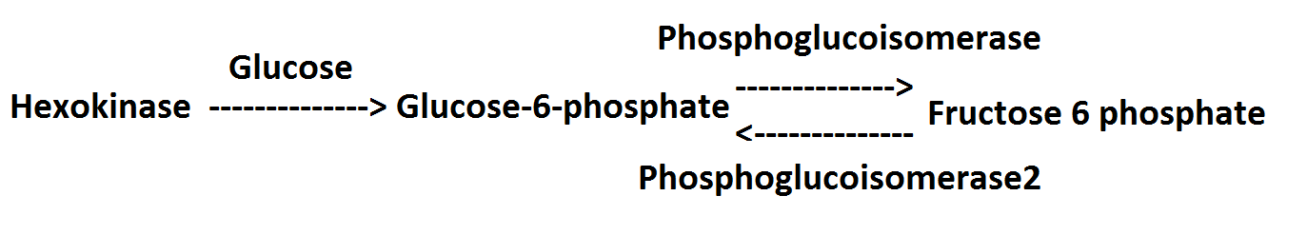
9. Phosphoglucoisomerase catalyzes gluose-6-phosphate to fructose-6-phosphate in a reversible fashion. Extend the model from Question 7 and simulate.

Slide 8
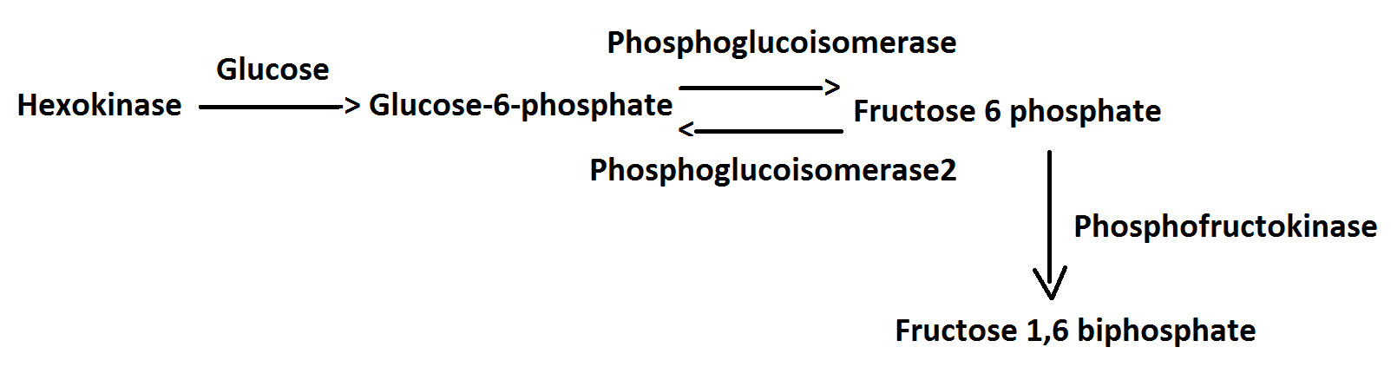
10. Phosphofructokinase catalyzes fructose-6-phosphate to fructose-1,6-bisphosphate in a non-reversible fashion. Extend the model from Question 9 and simulate.

Slide 9
11. Fructose phosphate aldolase catalyzes fructose-1,6-bisphosphate to glyceraldehyde-3-phosphate and dihydroxyacetone phosphate in a reversible fashion. Extend the model from Question 10 and simulate.

Slide 10
12. Actually, glucose-6-phosphate is also the substrate for glucose-6-phosphate dehydrogenase, which forms 6-phosphogluconolactone as the first step of Pentose Phosphate Pathway. Modify the model from Question 11, simulate and how will the steady-state concentration of dihydroxyacetone change as a result of this branching?

